Slide 1
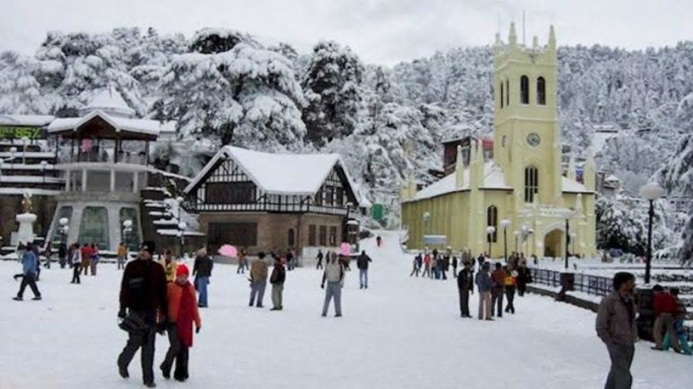
THE BATTLE OF NEIGHBOURHOODS CAPSTONE PROJECT

Slide 2
INTRODUCTION TO BUSINESS PROBLEM
NOW FOR THIS:-
• RETERIVE THE HOTELS IN SHIMLA WITHIN RADIUS OF 1000 METER.
• OBTAIN THERE LOCATION BY GEOCODER
• THEN SHOW N THE MAP HOTELS WHICH ARE SITUATED IN SHIMLIA CITY WITHIN 1000 M
SHIMLA IS A TOURIST PLACE AT A NORTHERN PART OF INDIA ALSO KNOWN AS A SUMMPER PART OF INDIA THIS PLACE CONSIST OF COLD WEATHER IN WINTER AS WELL AS IN SUMMER ALSO BECAUSE OF HILLS AND HAVING HIMALYA SITUTAED IN IT. SHIMLA HAS A VERY NICE WEATHER AND ALSO CALLED BEAUTY HILLS AND IT HAVE ALSO A GOOD MARKET OF MALL ROAD THERE IS ALSO A TOY TRAIN WHICH TRAVEL BETWEEN THE HILLS OF SHIMLA .
I WOULD LIKE TO OPEN MY HOTEL IN THAT PLACE WHERE EVERY PLACE LIKE MALL ROAD, LAKE ETC ARE NEARE TO EACH OTHER SO THAT TOURISTS CAN VISIT ALL THE FAMOUS PLACES IN SHILA I WOUULD ALSO RECOMMEND MY HOTEL TO HAVE ALL TYPE OFF FOODS AND FACILUTY SO THAT IT DOESNT FELL UNCOMFORTABLE FOR ANY TOURIST THIS TYPE

Slide 3
DATA
I HAVE USED FOURSQUARE API FOR THIS TO FIND THE HOTELS IN THE PROJECT FOR THIS I HAVE USE THE CODE
address = 'Shimla, Himachal Pradesh'
geolocator = Nominatim(user_agent="foursquare_agent")
location = geolocator.geocode(address)
latitude = location.latitude
longitude = location.longitude
print(latitude, longitude)
IN ABOVE CODE I CAN FIND THE LOCATION OF MY PLACE
search_query='hotel'search_quuery_res='restaurant'radius =1000url_hotel =
'https://api.foursquare.com/v2/venues/search?client_id={}&client_secret={}&ll={},{}&v={}&query={}&radius={}&limit={}'.format(CLIENT_ID, CLIENT_SECRET, latitude, longitude, VERSION,
search_query, radius, LIMIT)url_restaurant= 'https://api.foursquare.com/v2/venues/search?client_id={}&client_secret={}&ll={},{}&v={}&query={}&radius={}&limit={}'.format(CLIENT_ID,
CLIENT_SECRET, latitude, longitude, VERSION, search_query, radius, LIMIT)url
FOR THIS I CAN FIND MY HOTEL AND RESTURANT IN SHIMLA

Slide 4
METHDOLOGY
METHDOLOGY IS A SECTION IS USED TO REPRESENT THE IMPORTANT PART OF MAIN COMPONENT OF THE PROJECT REPORT WITH EXPLORATORY DATA ANALYSIS AND INFERIAL STASTICAL ANALYSIS .
THE DATA CONSIST OF HOTELS AND RESTURANT IN SHIMLA WITHIN 1000M BY USING THE FOURSQUARE API WILL GATHER THE DATA FOR THE TOP MOST VENEUS OF DATA IN SHIMLA NEIGHBOURHOOD.
CREATED THE DATASETS FOR THE HOTELS PRESENT IN SHIMLA
APPEEND THE DATA WITH THE LATITUDE AND LONGITUTDE VALUES RETRIVE FROM GEOCODER
USE THE FOURSQUARE APP TO RETRIVE THE VENUES OF ALL THE HOTELS PRESENT IN 100M
APPLY ONE HOT ENCODING AND NORMALIZED OF DATA THE VENUES
APPLIED K MEANS CLUSTERING ALGORTHIM
EXAMINED THE MAP AND DATA GENERATED WITH CLUSTER LABELS

Slide 5
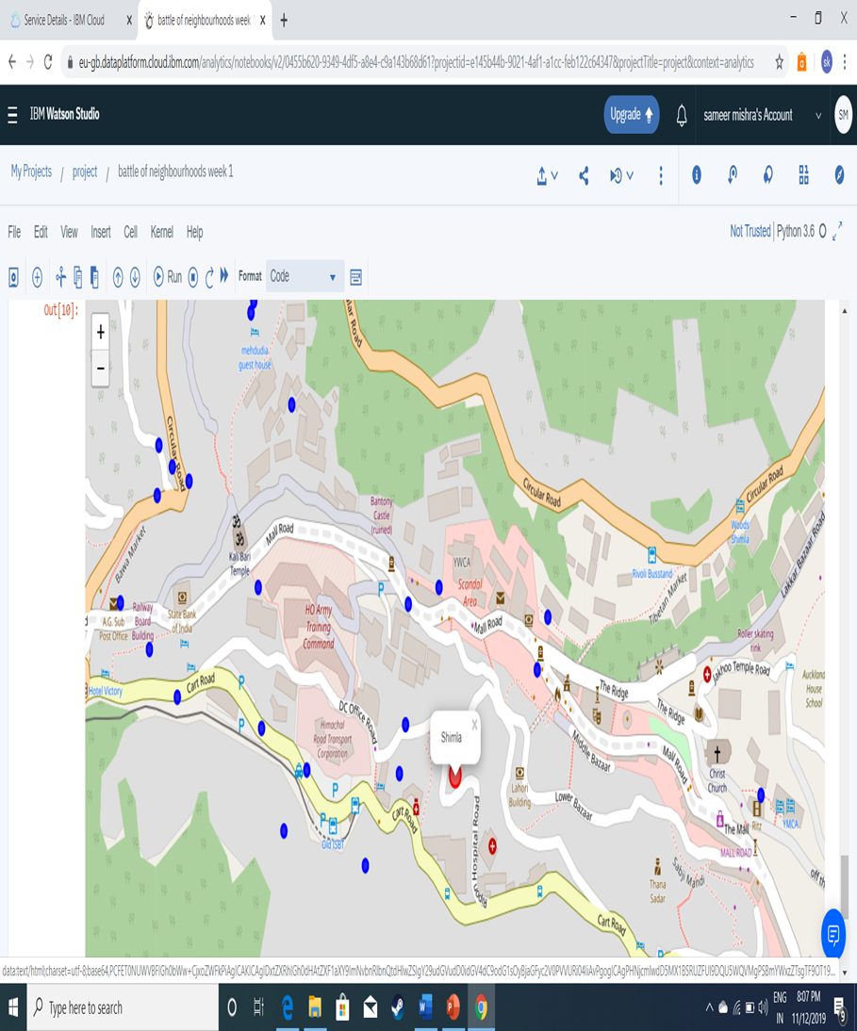
RESULTS

Slide 6
CONCLUSION
PURPOSE OF THE SEMINAR IS TO COMPARE THE HOTELS OF THE SHIMLA AND DETERMINE WHICH IS HOTEL BEST TO CHOOSE FOR HAVING ALL FACILITES AND CLOSER TO THE ALL THE PLACES IN SHIMLA IT WOULD BE BENEFICAL FOR THE TOURIST .

